Slide 1
Speed Control of DC Motor

Slide 2

The speed of a DC motor (N) is equal to
Therefore speed of the 3 types of DC motors – shunt, series and compound can be controlled by changing the quantities on the right-hand side of the equation above.
Hence the speed can be varied by changing:
The terminal voltage of the armature, V.
The external resistance in armature circuit, R_{a}.
The flux per pole, φ.
Therefore speed control of DC motor can be classified into:
Armature Control Methods
Field Control Methods

Slide 3
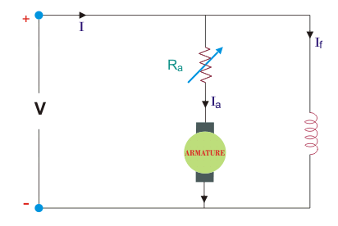
Armature Controlled DC Shunt Motor
Armature controlled DC shunt motor can be performed in two ways:
Armature Resistance Control
Armature Voltage Control
Armature Resistance Control
In armature resistance control a variable resistance is added to the armature circuit. Field is directly connected across the supply so flux is not changed due to variation of series resistance. This is applied for DC shunt motor. This method is used in printing press, cranes, hoists where speeds lower than rated is used for a short period only.
Armature Voltage Control
This method of speed control needs a variable source of voltage separated from the source supplying the field current. This method avoids disadvantages of poor speed regulation and low efficiency of armature-resistance control methods.

Slide 4
Advantages of Armature Controlled DC Shunt Motor
Very fine speed control over whole range in both directions
Uniform acceleration is obtained
Good speed regulation
It has regenerative braking capacity
Disadvantages of Armature Controlled DC Shunt Motor
Costly arrangement is needed, floor space required is more
Low efficiency at light loads
Drive produced more noise.

Slide 5
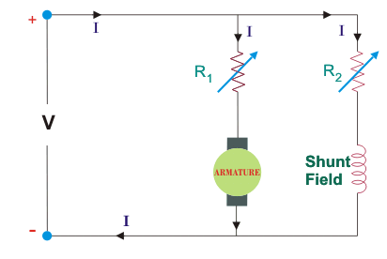
Field Controlled DC Shunt Motor
By this method a DC Shunt motor’s speed is controlled through a field rheostat.
Field Rheostat Controlled DC Shunt Motor
In this method, speed variation is accomplished by means of a variable resistance inserted in series with the shunt field. An increase in controlling resistances reduces the field current with a reduction in flux and an increase in speed. This method of speed control is independent of load on the motor.
Disadvantages of Field Rheostat Controlled DC Shunt Motor
Creeping speeds cannot be obtained.
Top speeds only obtained at reduced torque.
The speed is maximum at minimum value of flux, which is governed by the demagnetizing effect of armature reaction on the field.

